Slide 1

NORTH EASTERN HILL UNIVERSITY Tura Campus ,794002, Meghalaya
Department Of Computer Application
Presentation on Major Project
Project Title: Design And Implementation of A “C Class” ISP
Submitted by :
Tridip Sarma
Roll No: 18MCA18
Reg.No: 18071011
MCA (6th Semester)
Internal Supervisor:
Dr. Anindya Halder
Teacher In-charge
Dept. of Computer Application
External Supervisor:
Mr. Bhaskar Baruah
CCNA Trainer@edux.net.in

Slide 2
Contents:
Introduction.
Objective of the Project.
Technologies Used.
Details of Technologies Used.
Simulation Tool used.
Few Snapshots of the Project.
Future Work.
References.

Slide 3
1.Introduction:
ISP: An ISP (Internet Service Provider) is a company that provides individuals and other companies access to the internet and related services such as web site building and virtual hosting. An ISP has the equipment and the telecommunication line access required to have a point-of-presence on the internet for the geographical area served.
C Class ISP: Class C (Secondary Switching Area) –This license is for only a particular secondary switching area. A secondary switching area is a government defined territory which could comprise of several small villages, towns or even districts.

Slide 4
2.Objective of the project:
Suppose a Network Engineer for the newly established C Class ISP in the state of Assam. They have their HQ in Guwahati and they are permitted to provide triple play services all across Assam. Now, job is to create a network design and implement it with the following consideration :
The last mile connectivity can be used both wired and wireless , as some towns have hilly tracks.
Every district HQ is connected to the Data Center in Guwahati.
The ISP has 2 lease circuits for load balancing and fail over - VSNL and STPI.
Home users have B/C Class private IP addresses.
Corporates can buy public routable IPs for a premium service.

Slide 5
3.Technologies Used:
DSL
Centralized WIFI using WLC(WIRELESS LAN)
NATTING(Static & Dynamic)
DHCP Server
DNS Server
WEB Server
OSPF

Slide 6
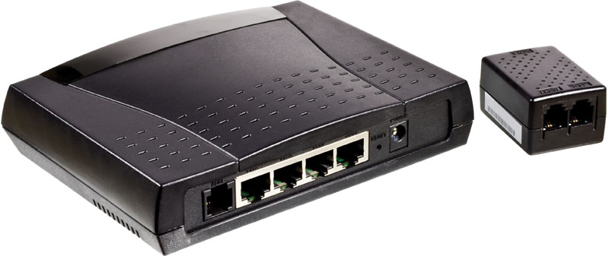
4.Details of Technologies Used: (I). DSL:

Slide 7
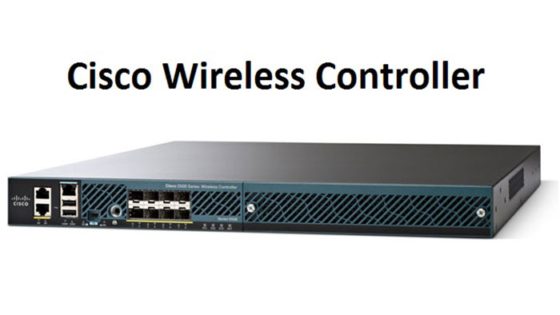
(II) Centralized WIFI Using WLC(wireless LAN):

Slide 8
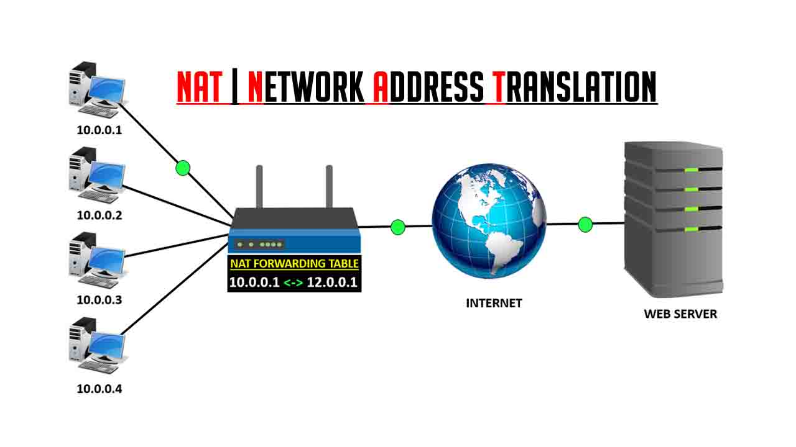
(III) NAT:

Slide 9
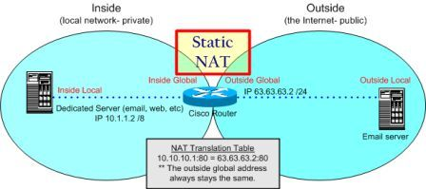
A) Static NAT:

Slide 10
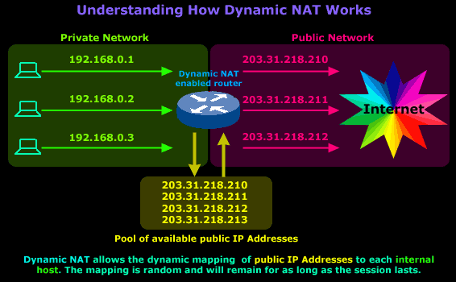
B) Dynamic NAT:

Slide 11

(IV) DHCP Server:

Slide 12
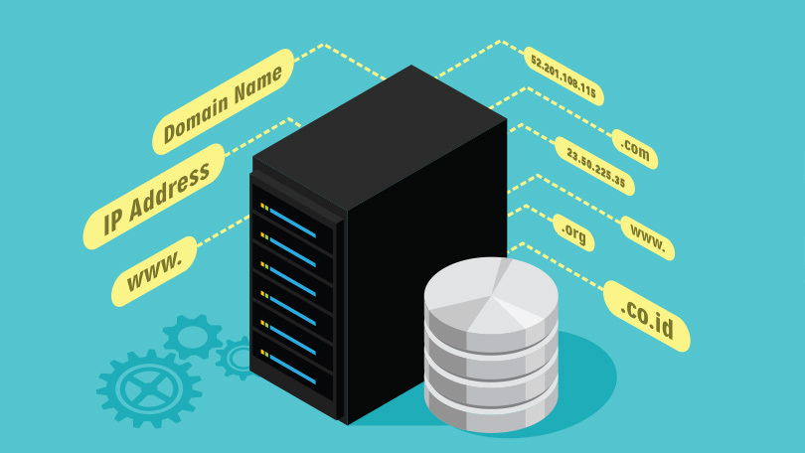
(V) DNS Server:

Slide 13

(VI) WEB Server:

Slide 14
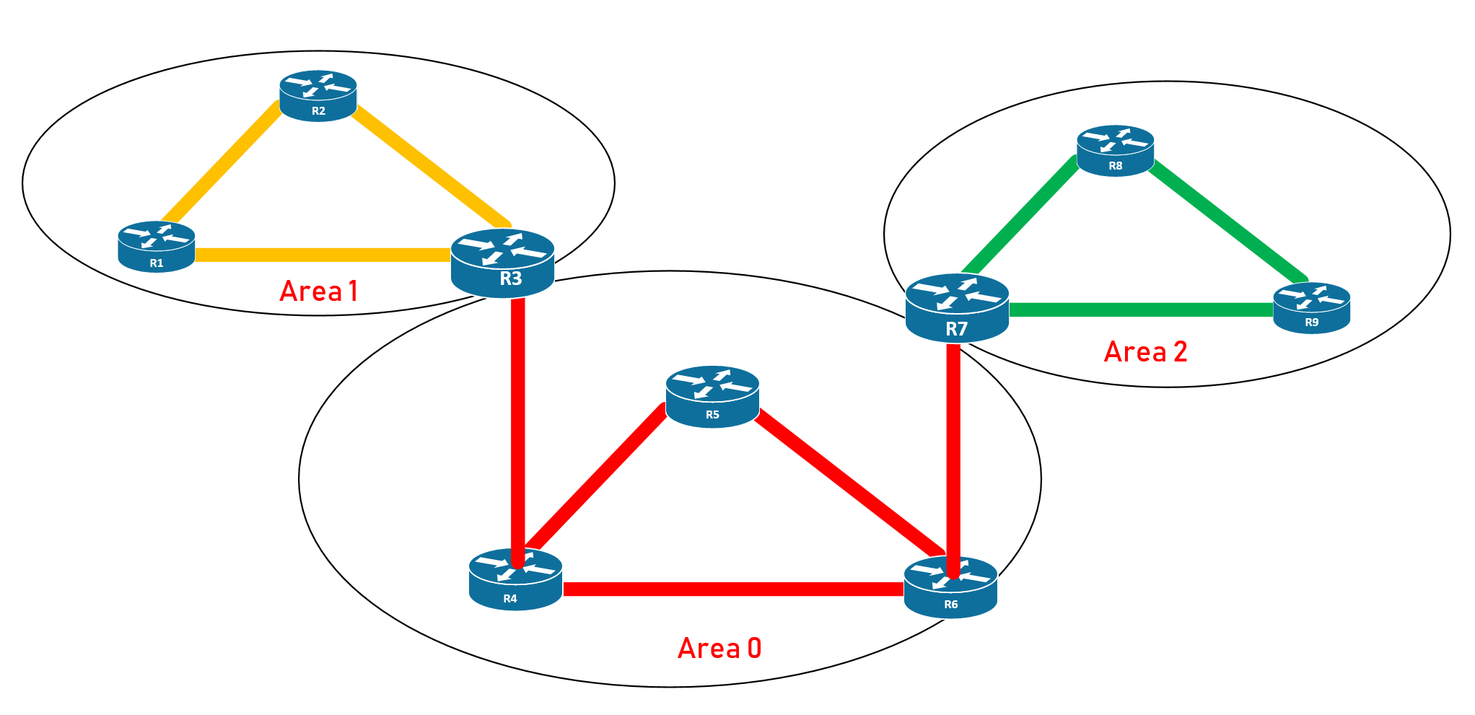
(VII) OSPF:

Slide 15
5.SIMULATION TOOL USED: CISCO PACKET TRACER https://www.netacad.com/courses/packet-tracer

Slide 16
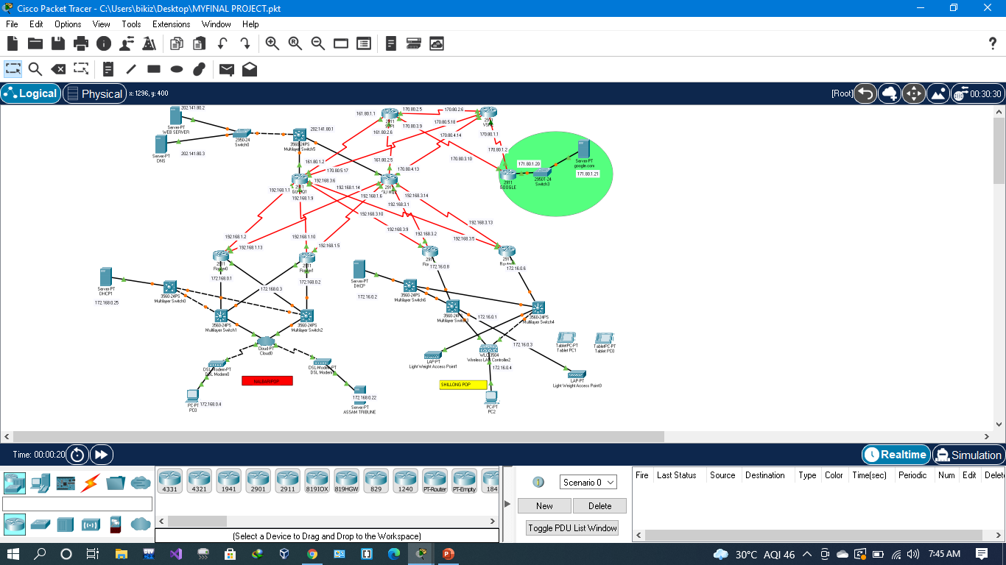
6.Few SNAPSHOTS of the Project:

Slide 17
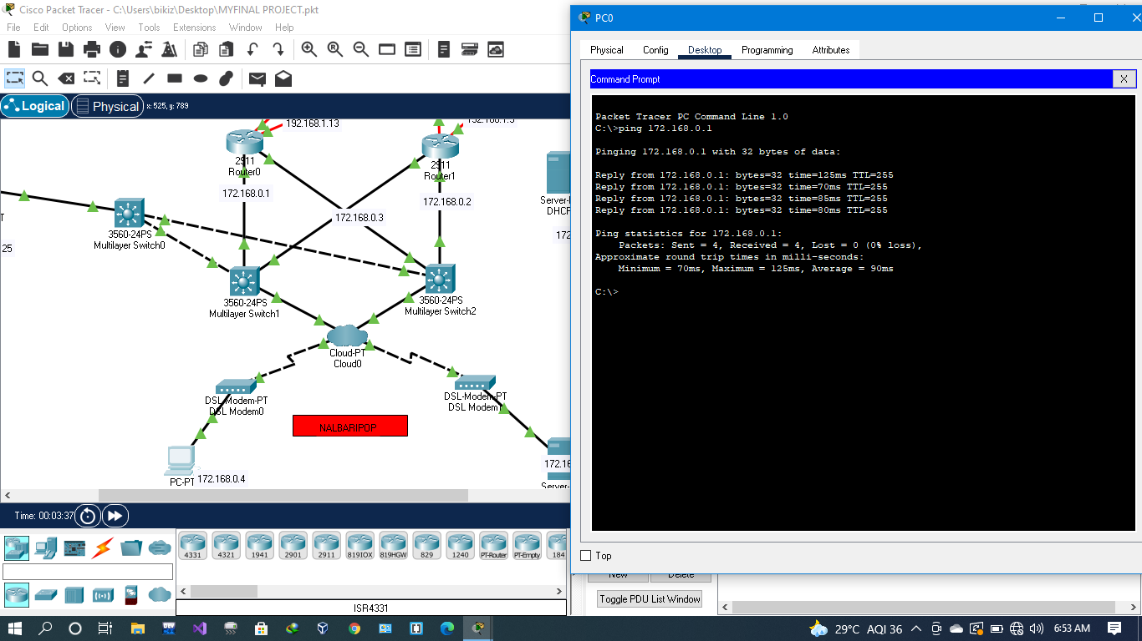

Slide 18
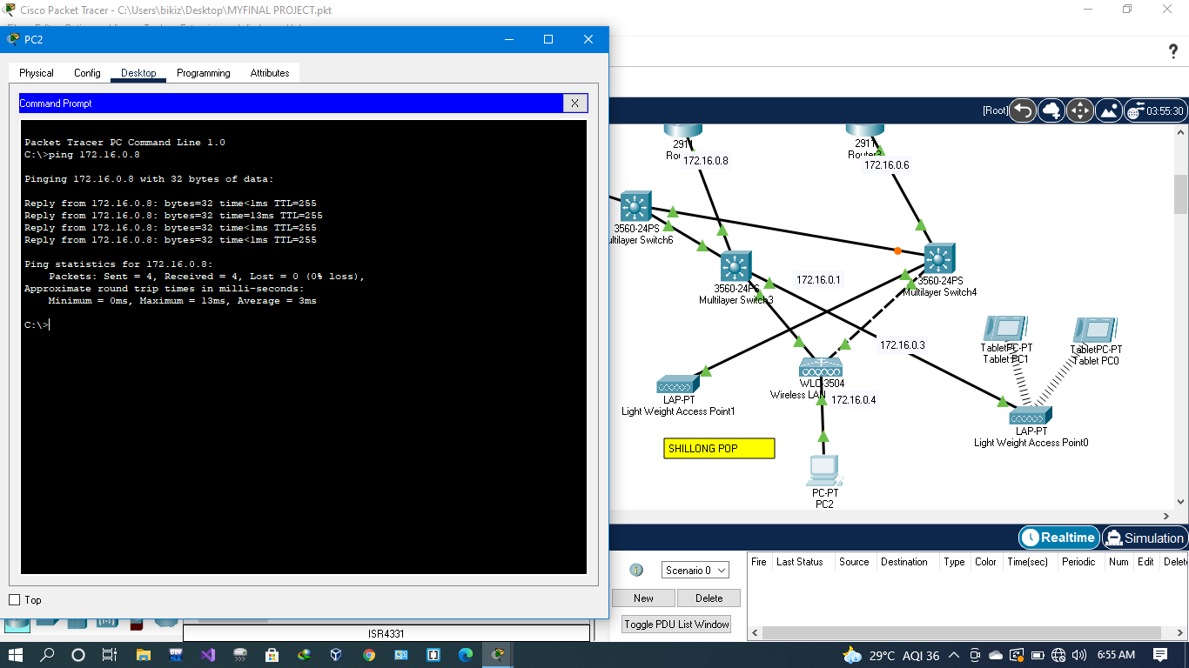

Slide 19
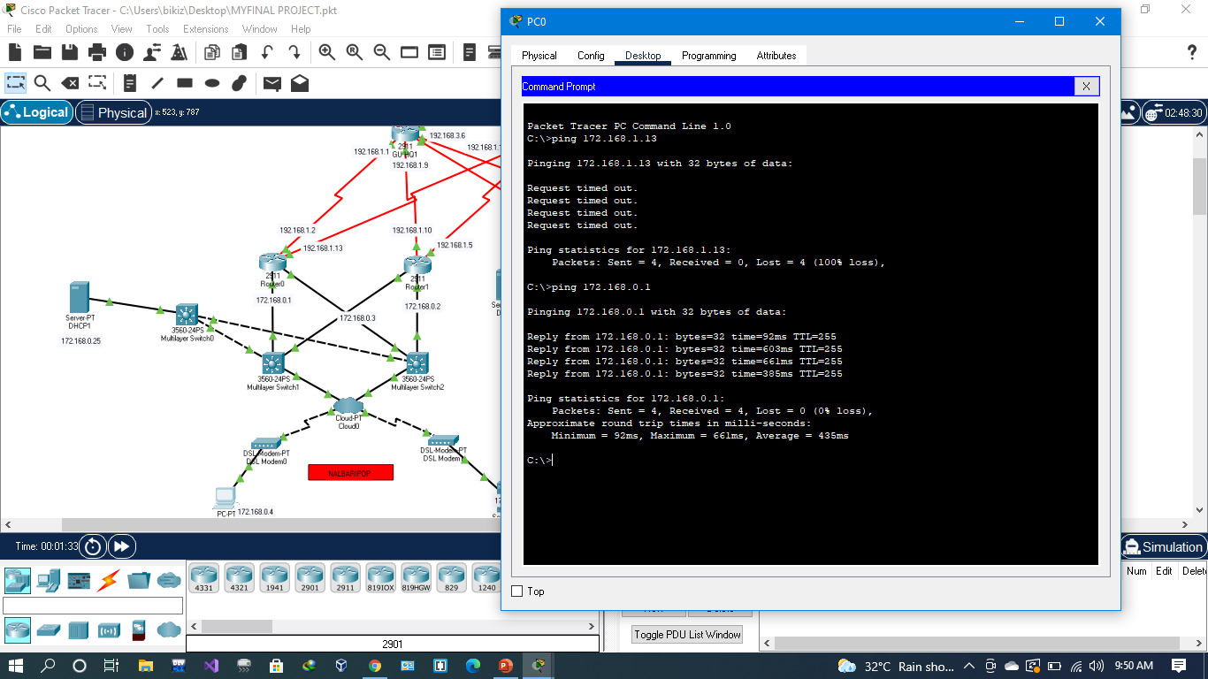

Slide 20
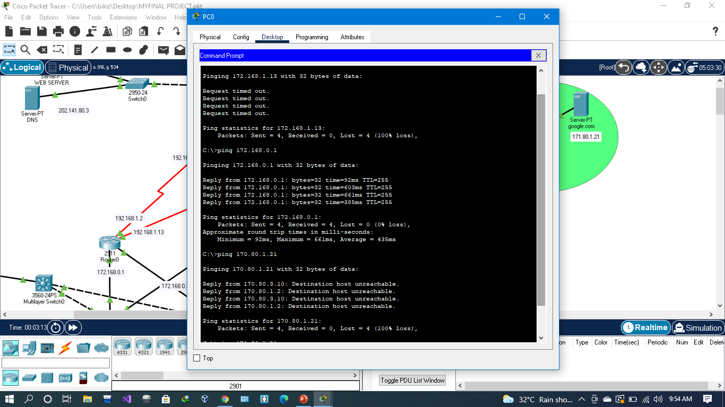

Slide 21
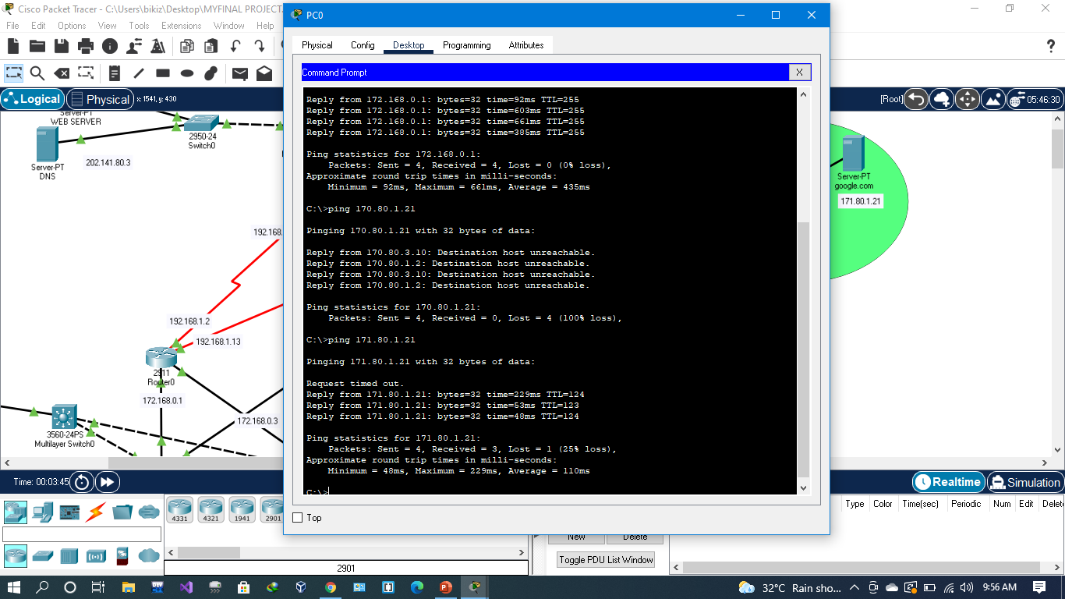

Slide 22
7.Future Work:
We can allow VPN services to the corporates.
QoS to prioritize traffic based on category.
Use OSPF as multiple area.

Slide 23
8.References:
https://www.youtube.com/channel/UCmGaNXkRL2IXha8ZN_Uae_Q
https://cybr.com/cybersecurity-fundamentals-archives/project-using-cisco-packet-tracer-to-learn-networking/
www.google.com

Slide 24
THANK YOU

